Slide 1
System Identification to support Flight Test activities
22.01.2018

Slide 2
Why to do this?
Aircraft stability and control derivatives obtained from this process allow:
1. Handling qualities evaluation
2. Data correlation for confidence in test techniques
3. Data generation for flight simulation
4. Flight control system design and optimisation
@ Kopter Group AG | Alejandro Valverde

Slide 3
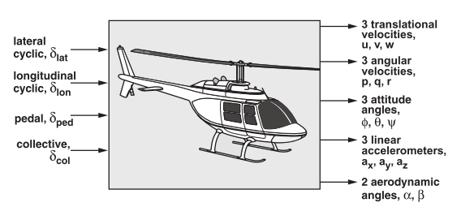
Problem overlook
@ Kopter Group AG | Alejandro Valverde

Slide 4
Why to introduce System ID into P3 test campaign?
To boost flight test productivity
System ID takes time and money – but not nearly as much as not doing it
@ Kopter Group AG | Alejandro Valverde

Slide 5
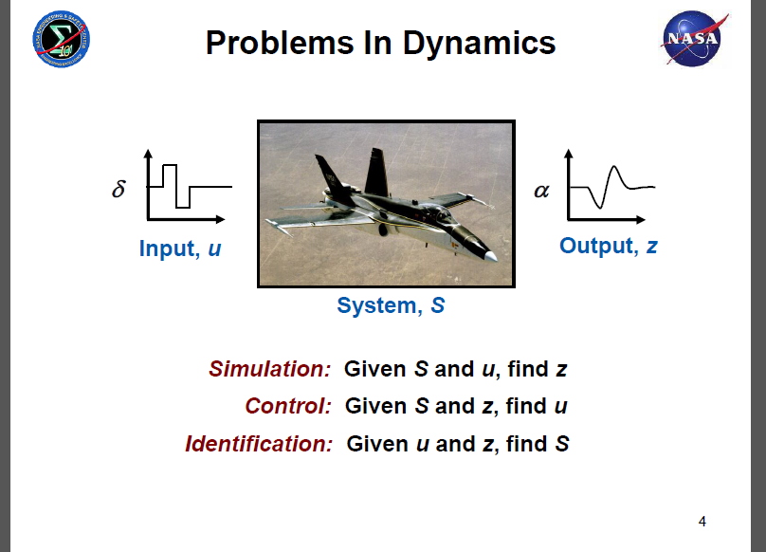
Basic problem in Dynamics
@ Kopter Group AG | Alejandro Valverde

Slide 6
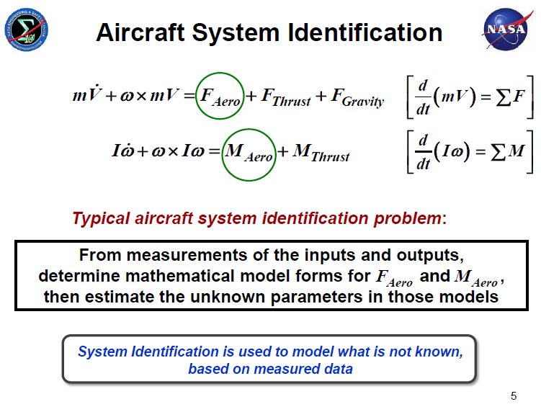
Aircraft System Identification
@ Kopter Group AG | Alejandro Valverde

Slide 7
Close the loop
Give those F_aero and M_aero to Nico and the guys from Flight Physics to validate FlightLab model when trying to predict dynamic behaviour of the system
@ Kopter Group AG | Alejandro Valverde

Slide 8
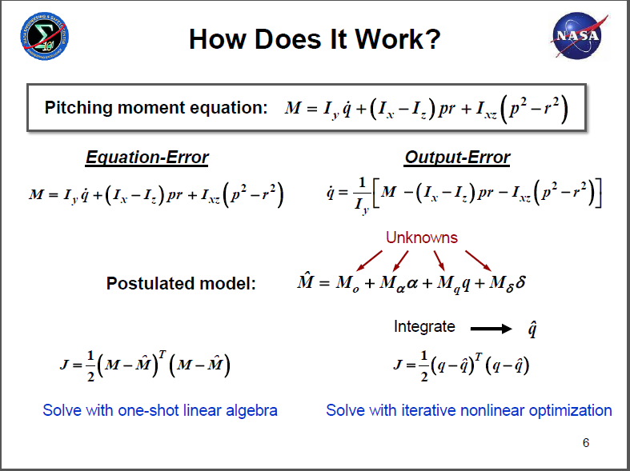
How does it work?
@ Kopter Group AG | Alejandro Valverde

Slide 9
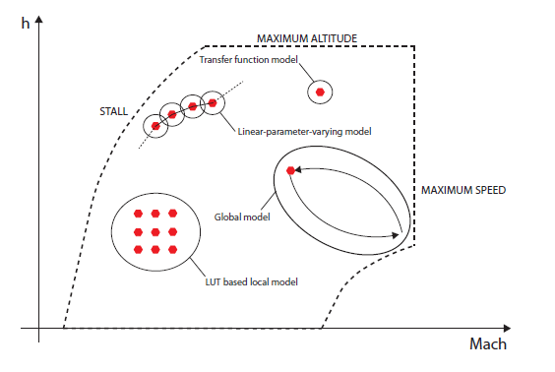
Flight envelope expansion
@ Kopter Group AG | Alejandro Valverde

Slide 10
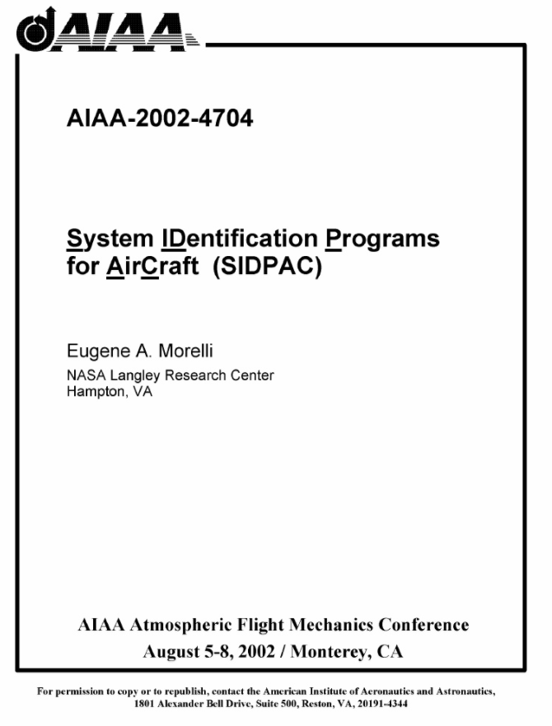
Tools
Already available
No development time needed
Proven industry suitable software
Further ways:
Python implementation
@ Kopter Group AG | Alejandro Valverde

Slide 11
What would I need?
A laptop
some accelerometers installed in P3, a part from the usual instrumentation…
Some coffee
@ Kopter Group AG | Alejandro Valverde

Slide 12
Tools
Give those F_aero and M_aero to Nico and the guys from Flight Physics to validate FlightLab model when trying to predict dynamic behaviour of the system
@ Kopter Group AG | Alejandro Valverde

Slide 13
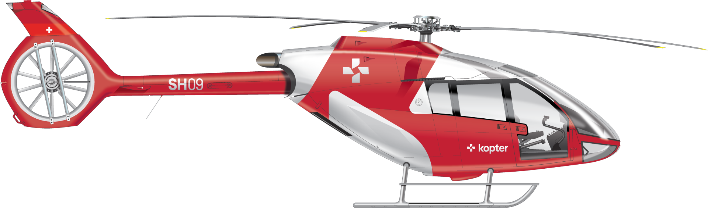
@ Kopter Group AG | Alejandro Valverde

Slide 14
Thank you

